Slide 1
Meeting the Washington Region’s Future Housing Needs A Framework for Regional Deliberations
From research to action

Slide 2
What is the Regional Housing Framework?
The Framework is a report that provides an empirical foundation for a “call to action” and for jurisdictions and other regional stakeholders to make forward-looking commitments to alleviate the region’s housing challenges
The Framework’s research and analysis was conducted by the Urban Institute but funded by the Greater Washington Partnership and JPMorgan Chase

Slide 3
Goals
Provide the foundation of facts and analysis necessary for the region’s jurisdictions, businesses, and housing advocates to come together around a shared vision and actionable strategies.
Rigorously assess the current and future housing needs in the Washington area
Identify regionwide targets for meeting future needs
Provide a portfolio of evidence-based tools and strategies
Assess the potential contribution of specific tools and strategies

Slide 4
Laying the Analytical foundation: Findings from the Regional Housing Framework

Slide 5
CURRENT HOUSING AFFORDABILITY CHALLENGE
Today’s housing stock doesn’t match the needs of the region’s households
Housing production has fallen short of past performance, leading to tighter markets
Housing costs are rising rapidly
The types and locations of housing contribute to higher costs
Not enough units affordable for the lowest and low-income households

Slide 6
The lowest income households have the highest share of housing cost burden
Income Level | Household Income | Occupations | Number of Households | Share of Households | % Cost Burden
Lowest | Less than $32,600 | Nursing assistants, parking attendants, food preparation workers | 307,000 | 15 | 84
Low | $32,600 to $54,300 | Substance abuse counselors, postal service clerks, or paramedics | 248,000 | 12 | 68
Low- Middle | $54,300 to $70,150 | Firefighters, crane operators, graphic designers | 183,000 | 9 | 47
Middle | $70,150 to $130,320 | Registered nurses, teachers, software developers | 577,000 | 29 | 19
High | $130,320 to $217,200 | Human resource managers, aerospace engineers, lawyers | 425,000 | 21 | 5
Highest | More than $217,200 | Chief executive officers, surgeons, psychiatrists | 272,000 | 14 | 1
Analysis conducted by the Urban Institute

Slide 7
Many households with low housing costs could afford to pay more
* Analysis conducted by the Urban Institute

Slide 8
There are not enough housing units available for households that need them in the lowest cost bands
Analysis by the Urban Institute

Slide 9
Additional Housing Units Needed by Cost to Accommodate Household Growth from 2015 to 2030
Urban projections based on MWCOG baseline forecast

Slide 10
REGIONAL SOLUTIONS: PROMISING POLICY TOOLS
To achieve a balanced mix of housing affordable up and down the income spectrum
Preserve existing affordable housing, including in opportunity-rich and revitalizing areas
Produce more housing across the income spectrum and in communities throughout the region so that all jurisdictions contribute to and benefit from meeting everyone's housing needs
Protect both renters and homebuyers from discrimination and displacement

Slide 11
Top 12 policy tools to implement, expand or strengthen
Preserve
Loans for repairs and rehabilitation
Preservation network and inventory
Public housing rehab
Financing for acquisition and rehab
Produce
Land value taxation
Up-zoning
Reduced parking requirements
Equitable transit-oriented development funds
Protect
Home purchase assistance
Land trusts, co-ops, and shared equity ownership
Emergency rental assistance
Local housing vouchers

Slide 12
Recommended Actions
The region’s leaders join to establish 10-year targets
Shrink the current affordability gap
Increase the pace of new housing production
Align additional housing units with expected household needs and resources
Local governments contribute to the achievement of regional targets
Adopt or strengthen evidence-based policy tools tailored to local needs and capacities
State governments strengthen local capacity local governments to achieve targets
Authorize increased public funding and regulatory authority
Business and philanthropy deploy their influence and convening power to build and sustain the regional commitment
Monitor progress toward targets
Contribute to public-private partnerships with greatest potential

Slide 13
Turning data into action

Slide 14
A PARTNERSHIP WITH COG
During the development of the Framework the Partnership leveraged the report’s data and worked closely with COG leadership to support a regional housing resolution to set regional housing production targets from the Metropolitan Washington Council of Governments (“COG”) board.
COG’s board led by its Chair Robert White (D.C. Council), co-Vice Chair Christian Dorsey (Arlington) and co-Vice Chair Derrick Davis (Prince George’s Council) then tasked a joint committee managed by Polly Donaldson (Director, D.C. Department of Housing and Community Development), Andrew Trueblood (Director, D.C. Office of Planning) and Helen Mcilvaine (Director, Alexandria Housing) to create the necessary policy blueprint to achieve a regional housing solution.

Slide 15
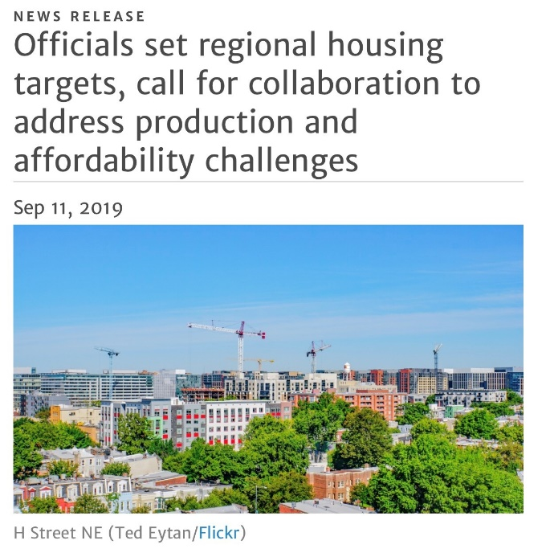
Establishing Regional Housing Targets
Using the Urban Institute’s data and with pushing from the regional business community, the Metropolitan Washington Council of Governments (COG) Board of Directors, which consists of leaders from the District of Columbia, Maryland, and Virginia, adopted three regional targets on housing, agreeing to collaboratively address the area’s production and affordability challenges.
Amount – At least 320,000 housing units should be added in the region between 2020 and 2030. This is an additional 75,000 units beyond the units already forecasted for this period.
Accessibility – At least 75% of all new housing should be in active centers or near high-capacity transit
Affordability – At least 75% of new housing should be affordable to low- and middle-income households

