Slide 1
MAS
UPDATE
Stephanie Shutt
Director Operations and Innovation

Slide 2
OVERVIEW
01
02
03
MAS at a Glance
Projects
Trends

Slide 3
MAS at a Glance
$50 B
$40 B
$30 B
$20 B
$10 B
$30 B
$20 B
$10 B
$6 B
$5 B
$4 B
$3 B
$2 B
$1 B

Slide 4
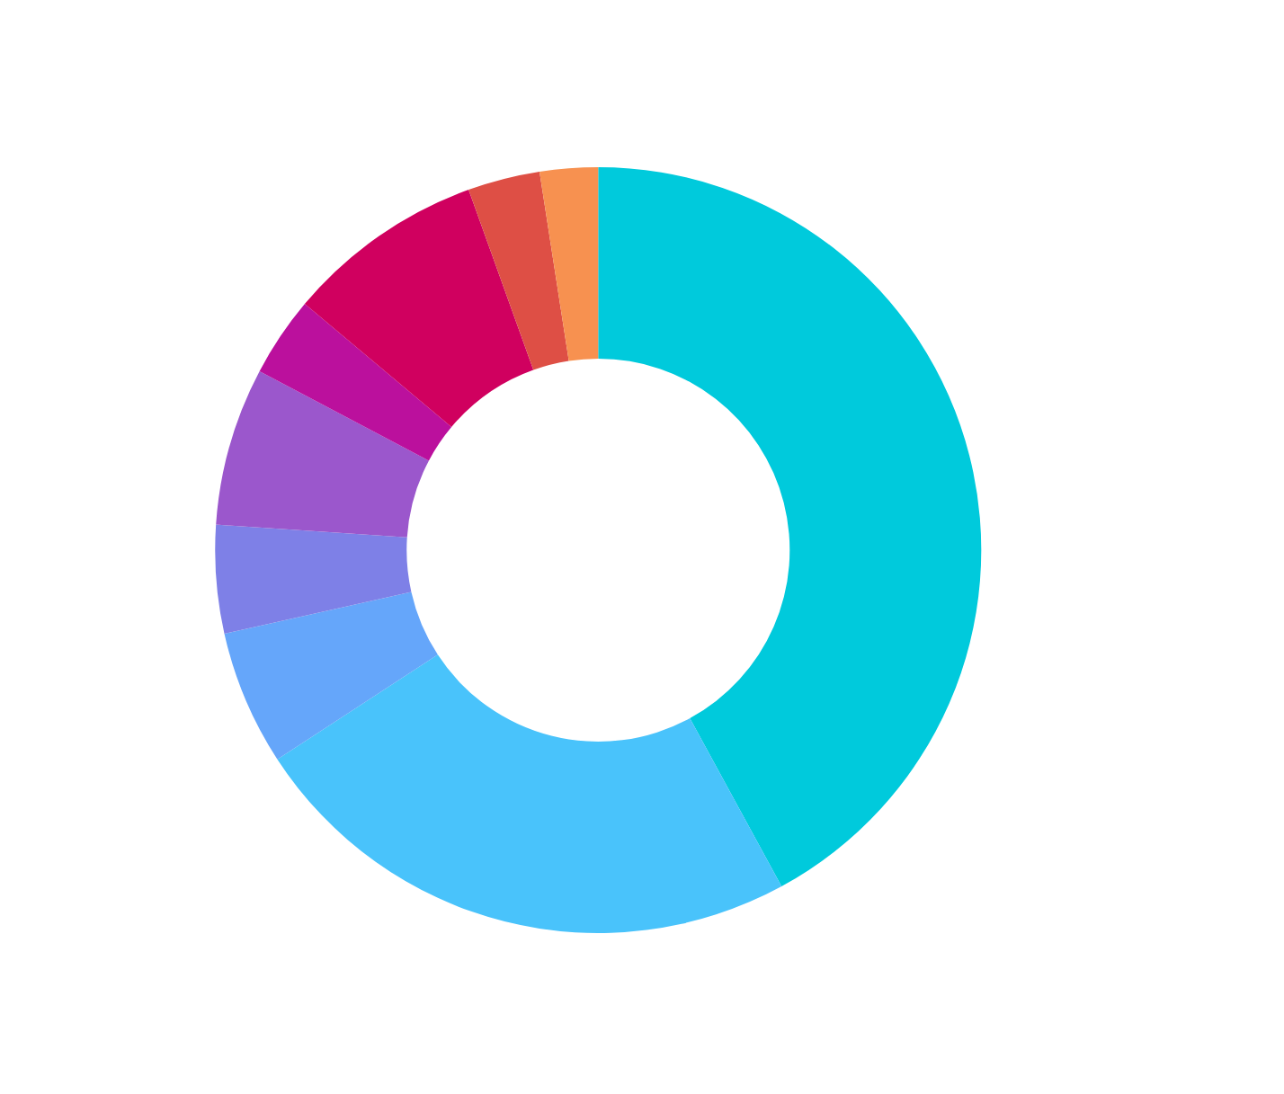
2023 MAS
Business
Volume

Slide 5
Consolidation
8(a)
Webpages
Joint Ventures
Consolidation

Slide 6
8(A) AND MAS
Sole Source Pool: Have gone through offer and acceptance with SBA and are actively listed in the SBA database. This status is sent to SAM.gov and that is then fed to MAS systems. GSA eLibrary will list the exit date based on the database.
6.6%
8.4%
Competitive Pool: Companies that have graduated from the 8(a) program however have not hit an option year.

Slide 7
MAS Webpage Updates
Over the past year we have reviewed and updated the look, feel and content on the MAS pages, this includes:
Updated MAS Roadmap
Updated landing page
Ability to search categories, subcategories, and SINs without going to eLibrary

Slide 8
PAST
SBA Joint Venture program created typically used for orders not large IDIQs such as MAS
2022
03
SBA Joint Ventures start to enter in the MAS program through the startup springboard program for IT, the startup springboard program is expanded to all of MAS
02
2023/2024
MAS solicitation is updated with Joint Venture offer processes and policy/training provided to the acquisition workforce
01

Slide 9
CONSOLIDATION PHASE III
CONSOLIDATION PLAN
CONSOLIDATED
Contractors have been submitting their individual plans
64% have completed consolidation
SINGLE CO
TIMING
Moving contracts to one CO for those contractors with multiple contracts - COMPLETED
Contractors should use pricing modifications as a time to move offerings. Also moving offering to one contract and not completing options where applicable.

Slide 10
PRIORITIES FOR 2024
TDR
Catalog
Systems
FAS has created an evaluation plan for the TDR program.
Expansion of contractors using the FAS Catalog Platform.
Getting off the mainframe and the future of the MAS systems

Slide 11
Contracting Trends
MULTIPLE AWARD BPA
CONTRACTING TEAMING
SB DISADVANTAGED
Small Business
Pricing
Safety Net
Small Business
Prime work
MAS coverage
Streamlined Purchasing

Slide 12
CONTACTS
Email
Contracting Officer
Industrial Operations Analyst
maspmo@gsa.gov

Slide 13
Questions

